Slide 1
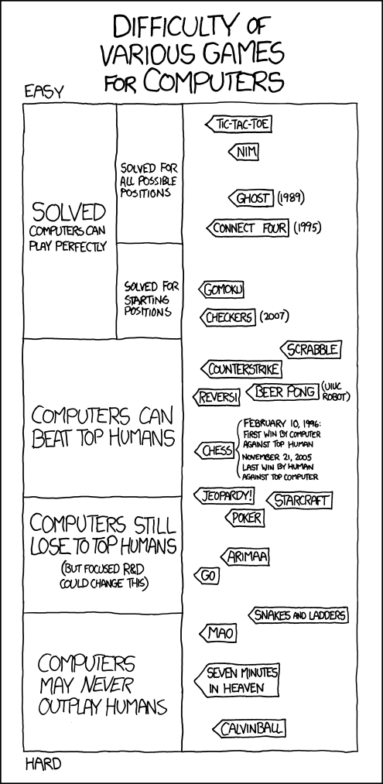
Distributed Q-Learning: A Democratic Learning Process
by Max Robinson
https://xkcd.com/1002/`
Notes:
To change the image on this slide, select the picture and delete it. Then click the Pictures icon in the placeholder to insert your own image.

Slide 2
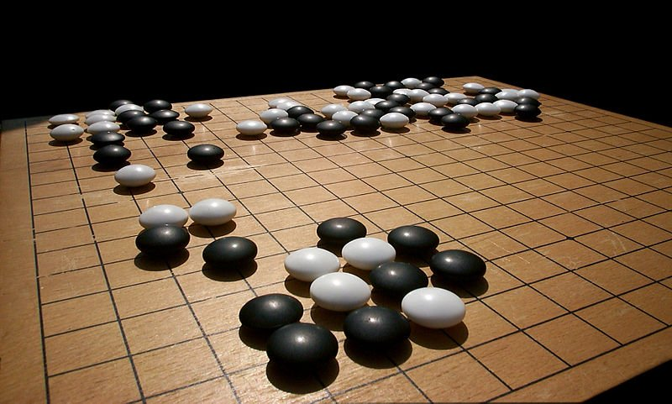
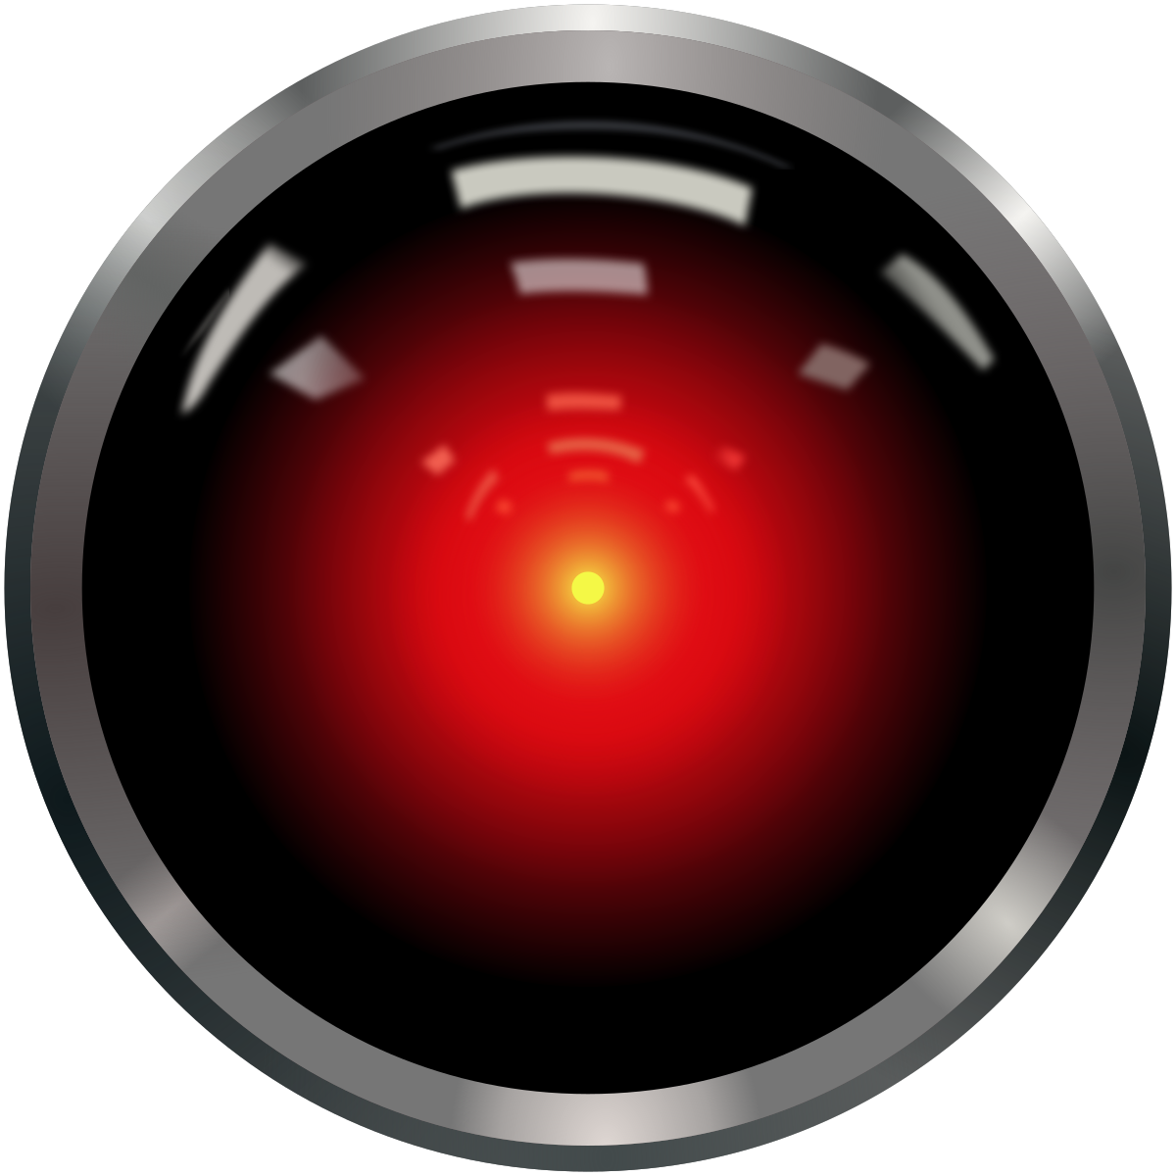
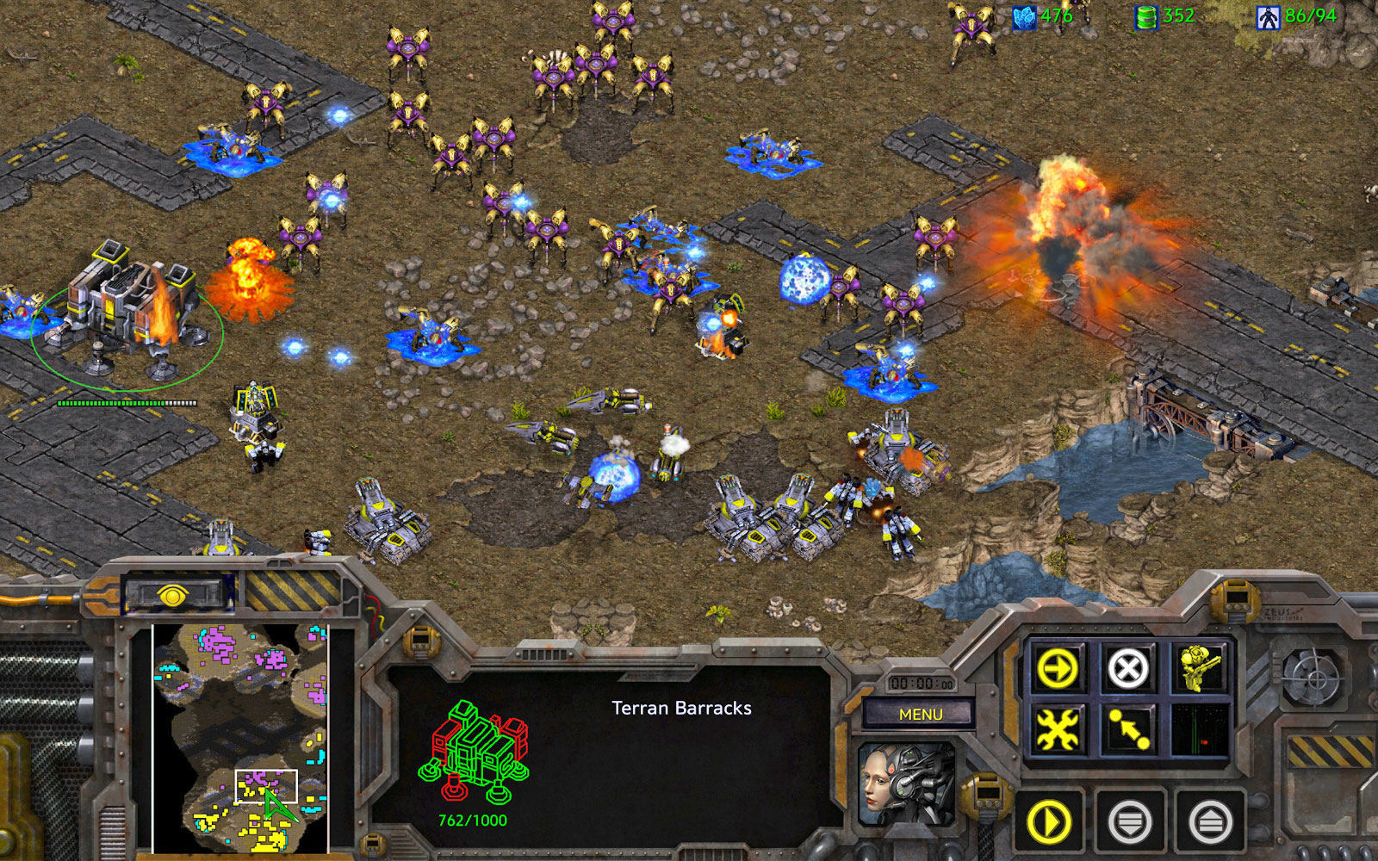
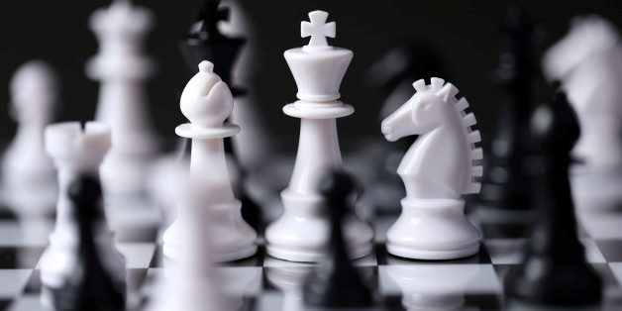
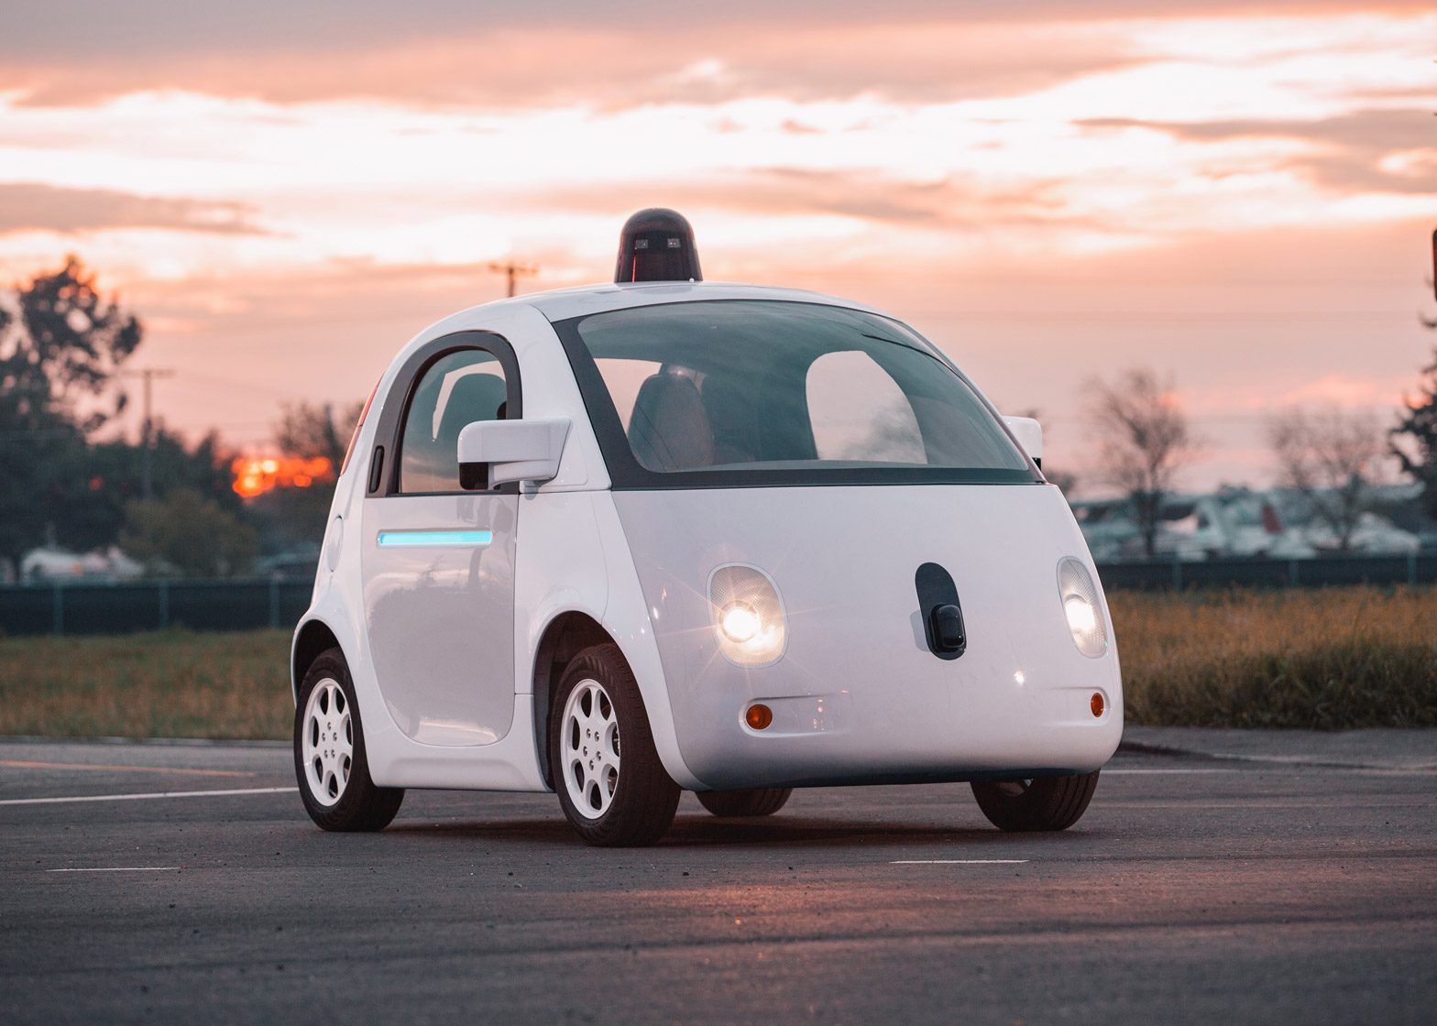
Why Reinforcement Learning?
Notes:
http://www.businessinsider.com/go-board-game-in-demand-after-google-deepmind-put-it-in-the-spotlight-2016-4?r=UK&IR=T
https://www.engadget.com/2017/03/26/starcraft-remastered/
http://www.unb.com.bd/sports-news/K-Kundu-leading-in-Sonargaon-Intl-FIDE-Rating-Chess/66315
https://en.wikipedia.org/wiki/HAL_9000
https://www.dezeen.com/2016/02/12/google-self-driving-car-artficial-intelligence-system-recognised-as-driver-usa/

Slide 3
Reinforcement Learning
State
Action
Observation & Reward

Slide 4
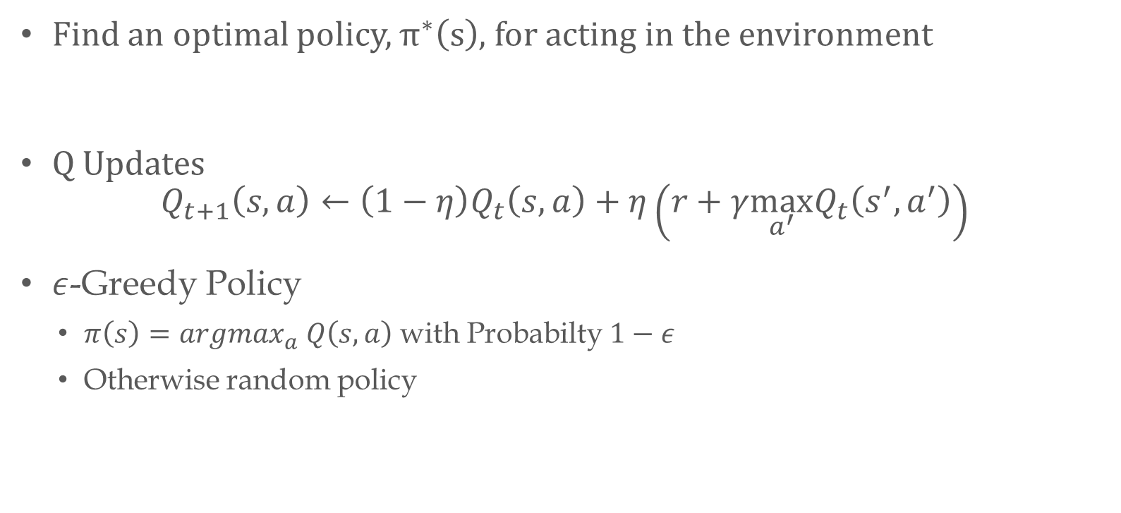
Q…-learning?
Find an optimal policy, $π^{∗}\left(s\right)$, for acting in the environment
Q Updates
$$Q_{t+1}\left(s,a\right)←\left(1−η\right)Q_{t}\left(s,a\right)+η\left(r+γ\max_{a^{′}}Q_{t}\left(s^{′}, a^{′}\right)\right)$$
$ε$-Greedy Policy
$π\left(s\right)=argmax_{a} Q\left(s,a\right)$ with Probabilty$1−ε$
Otherwise random policy

Slide 5
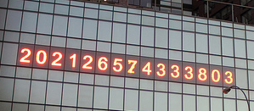
So what is wrong? Why distributed learning?
Problem?
Number of episodes required for single agent can be very large
Experience is sequential for a single agent
Distributed
Could decrease number of episodes needed for an individual agent
Flexibility in experience and exploration
Scalability
Notes:
https://untappedcities.com/2013/10/08/daily-what-what-are-those-numbers-counting-in-union-square/

Slide 6
Previous Work
Asynchronous updates can still maintain Q-learning optimality (Tsitsiklis, 1994)
Multi-agents with a single Q-table (Mannion et al. 2015)
General Reinforcement Learning Architecture (Gorila) (Nair et al. 2015)

Slide 7
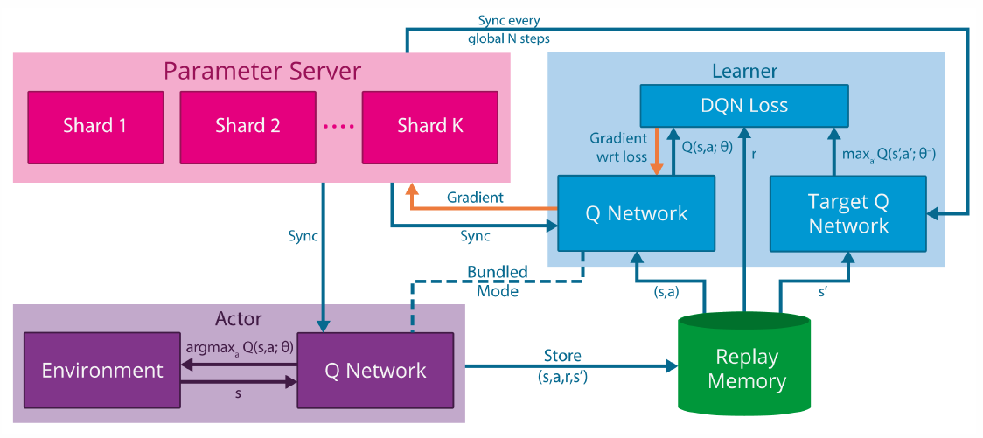
Gorila Architecture

Slide 8
Distributed Q-learning (DistQL)

Slide 9
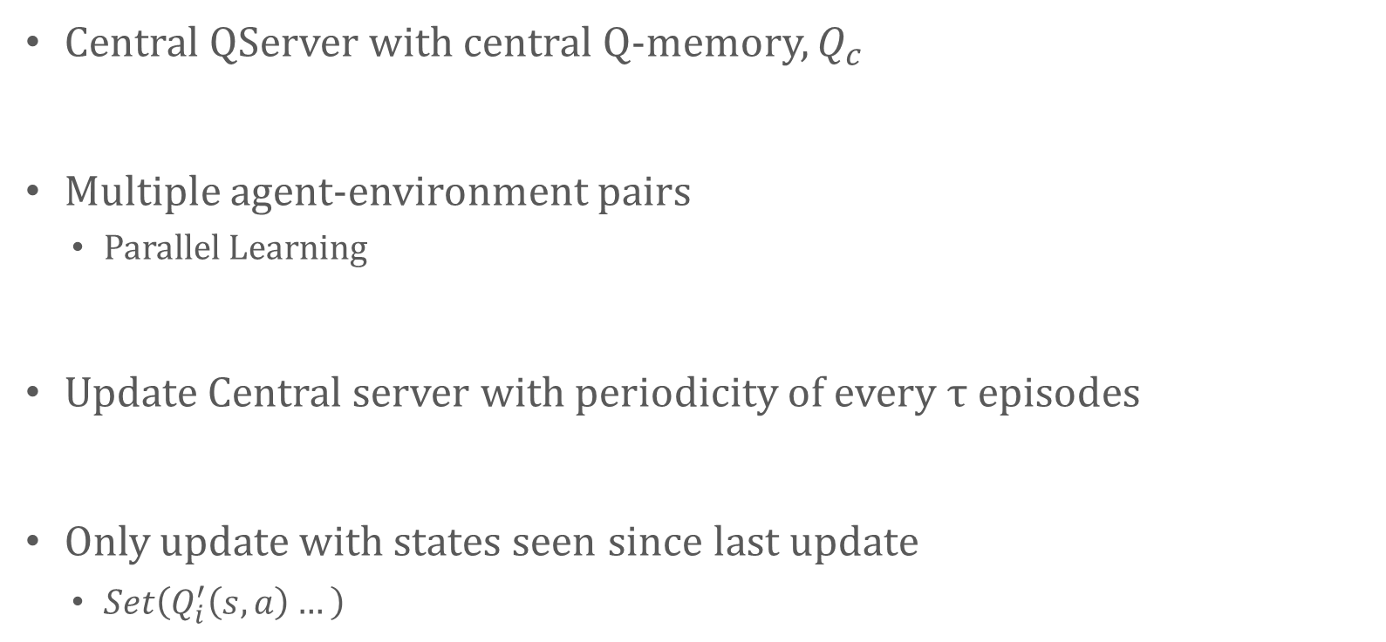
How DistQL Works
Central QServer with central Q-memory, $Q_{c}$
Multiple agent-environment pairs
Parallel Learning
Update Central server with periodicity of every $τ$ episodes
Only update with states seen since last update
$Set\left(Q_{i}^{′}\left(s,a\right)…\right)$

Slide 10
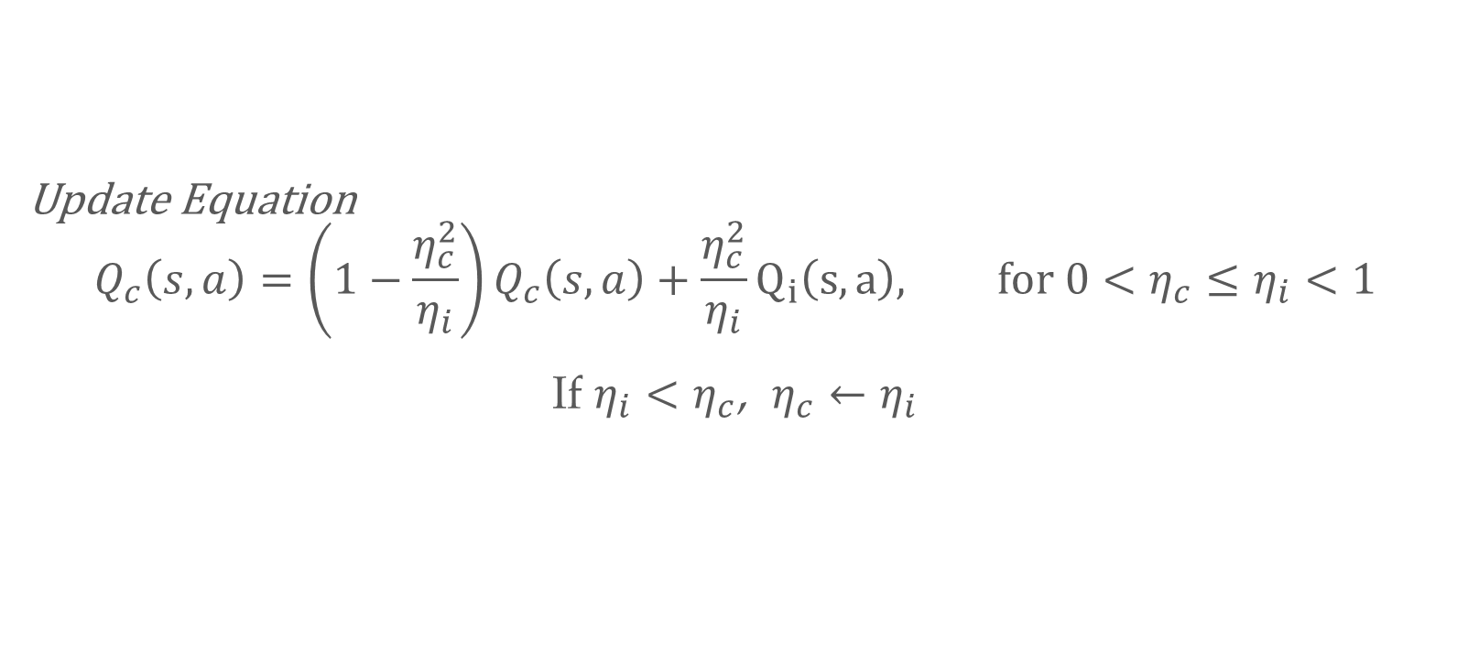
Central Update Function
Update Equation
$$Q_{c}\left(s,a\right)=\left(1−\frac{η_{c}^{2}}{η_{i}}\right)Q_{c}\left(s,a\right)+\frac{η_{c}^{2}}{η_{i}}Q_{i}\left(s,a\right), for 0<η_{c}≤η_{i}<1$$
If ${η_{i}<η}_{c}$, $η_{c}←η_{i}$

Slide 11
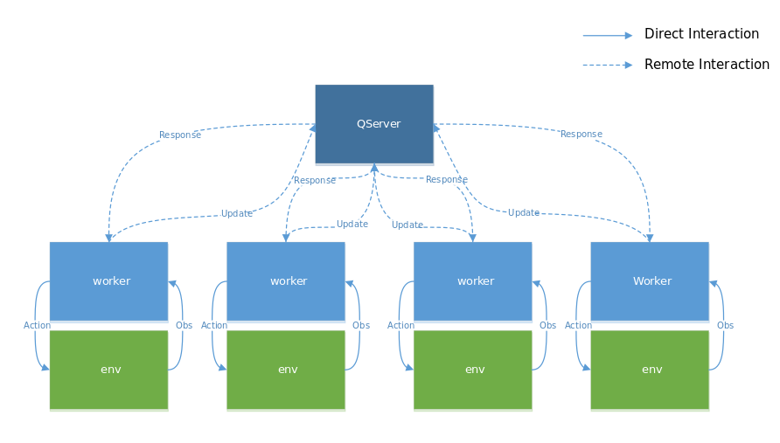
DistQL Architecture

Slide 12
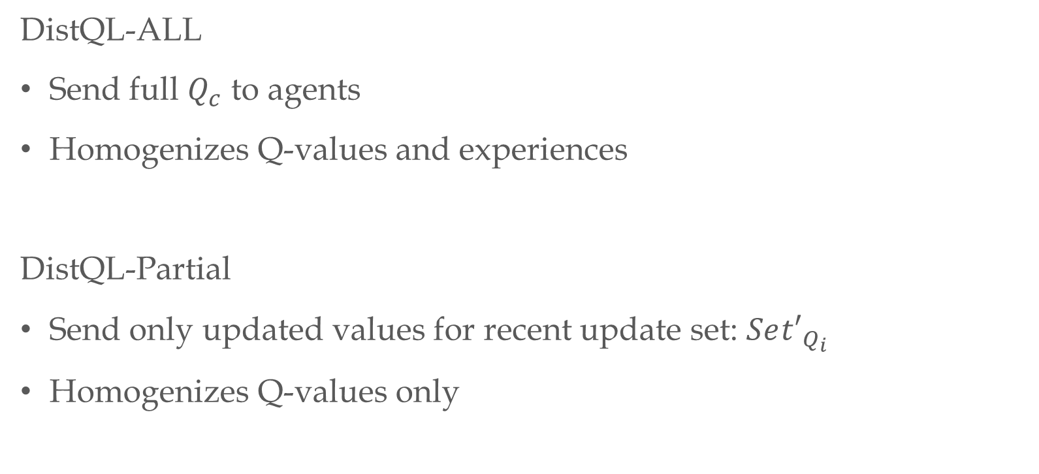
DistQL Update Methods
DistQL-ALL
Send full $Q_{c}$ to agents
Homogenizes Q-values and experiences
DistQL-Partial
Send only updated values for recent update set: $Se{t′}_{Q_{i}}$
Homogenizes Q-values only

Slide 13
Experiments

Slide 14
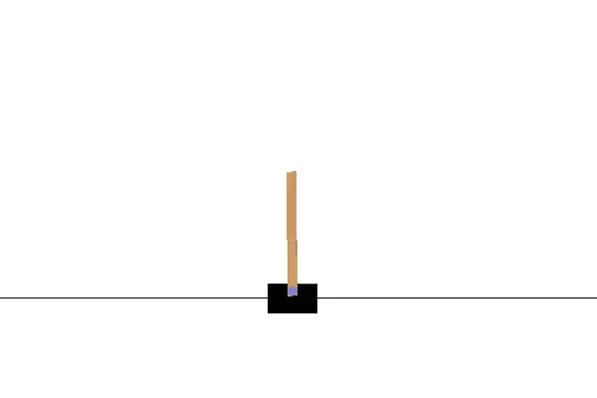
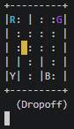
Experiments
Taxi World
Cart Pole

Slide 15
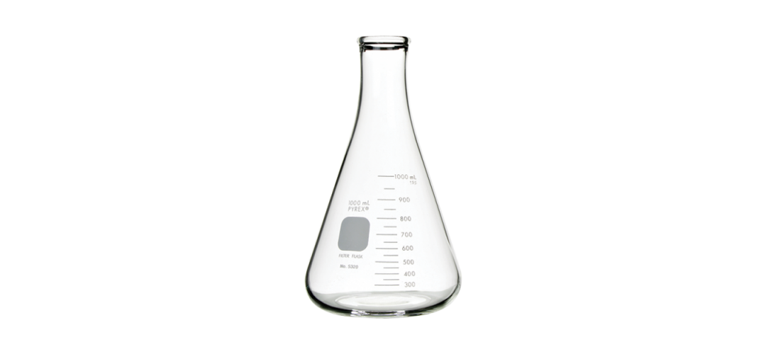
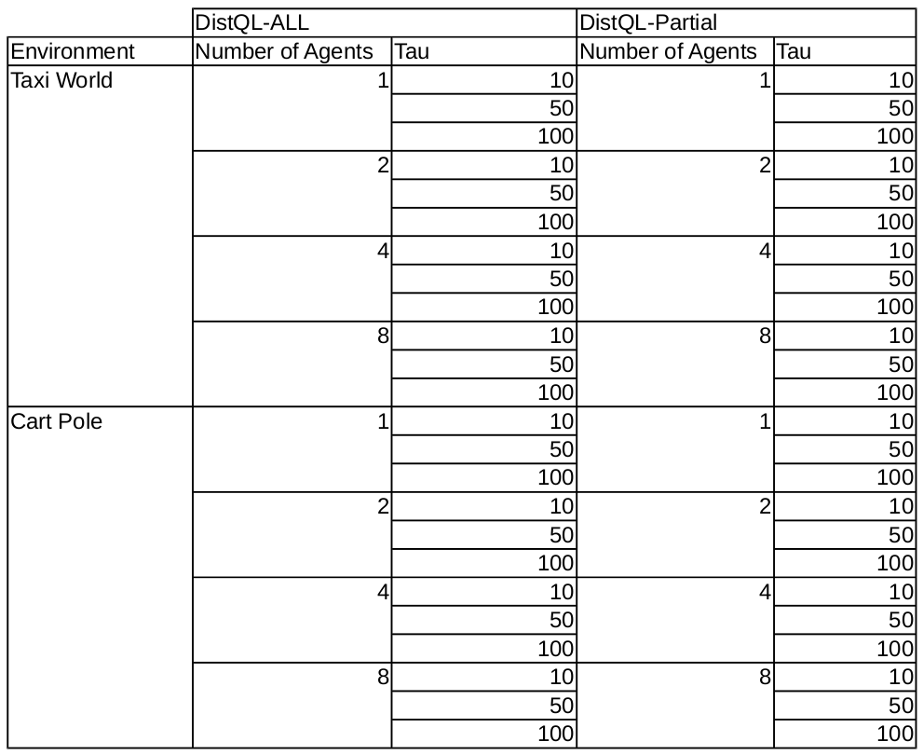
Experiments Enumerated
42!!! Errr... I mean 48
Notes:
https://www.humboldtmfg.com/erlenmeyer-flask.html

Slide 16
How did DistQL do?

Slide 17
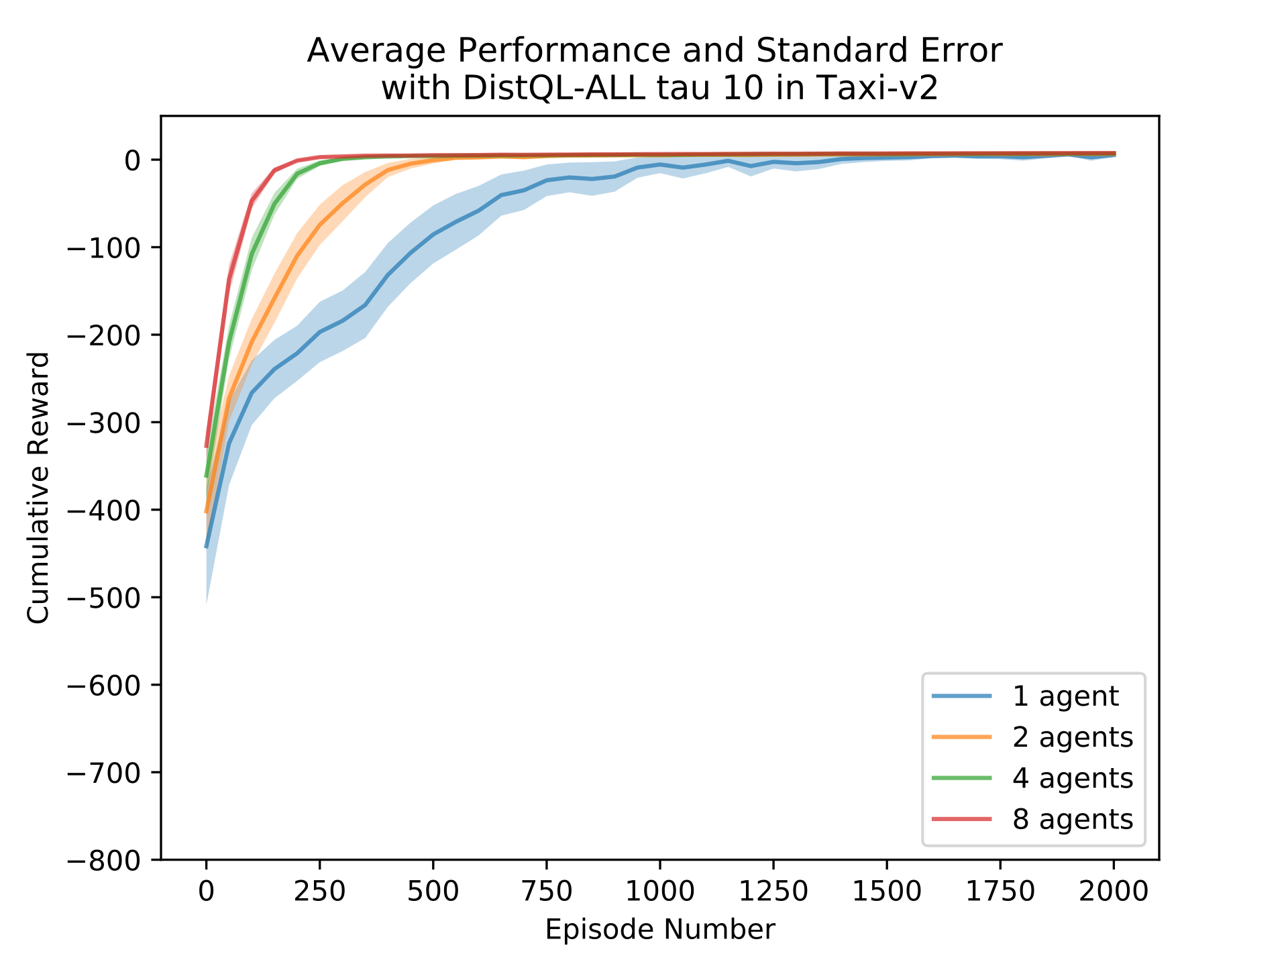
Taxi World
DistQL-ALL shows significant performance increases as the number of agents increases

Slide 18
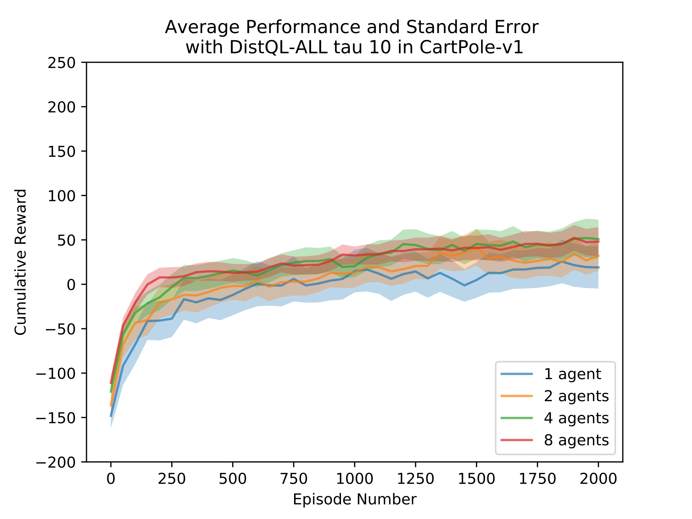
Cart Pole
DistQL-ALL shows increased performance

Slide 19
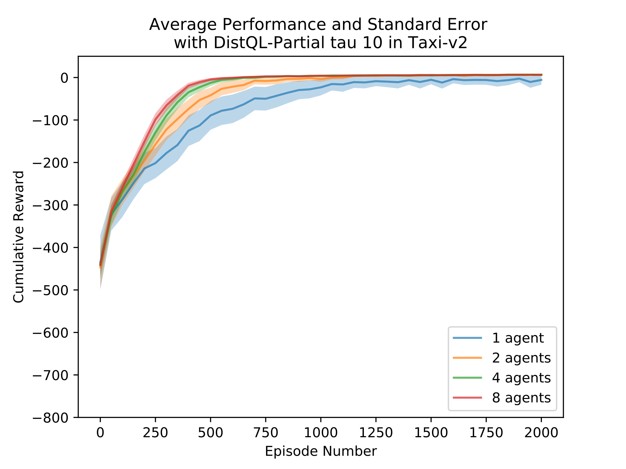
DistQL-ALL vs DistQL-Partial Taxi World
DistQL-ALL out performed DistQL-Partial for all agents

Slide 20
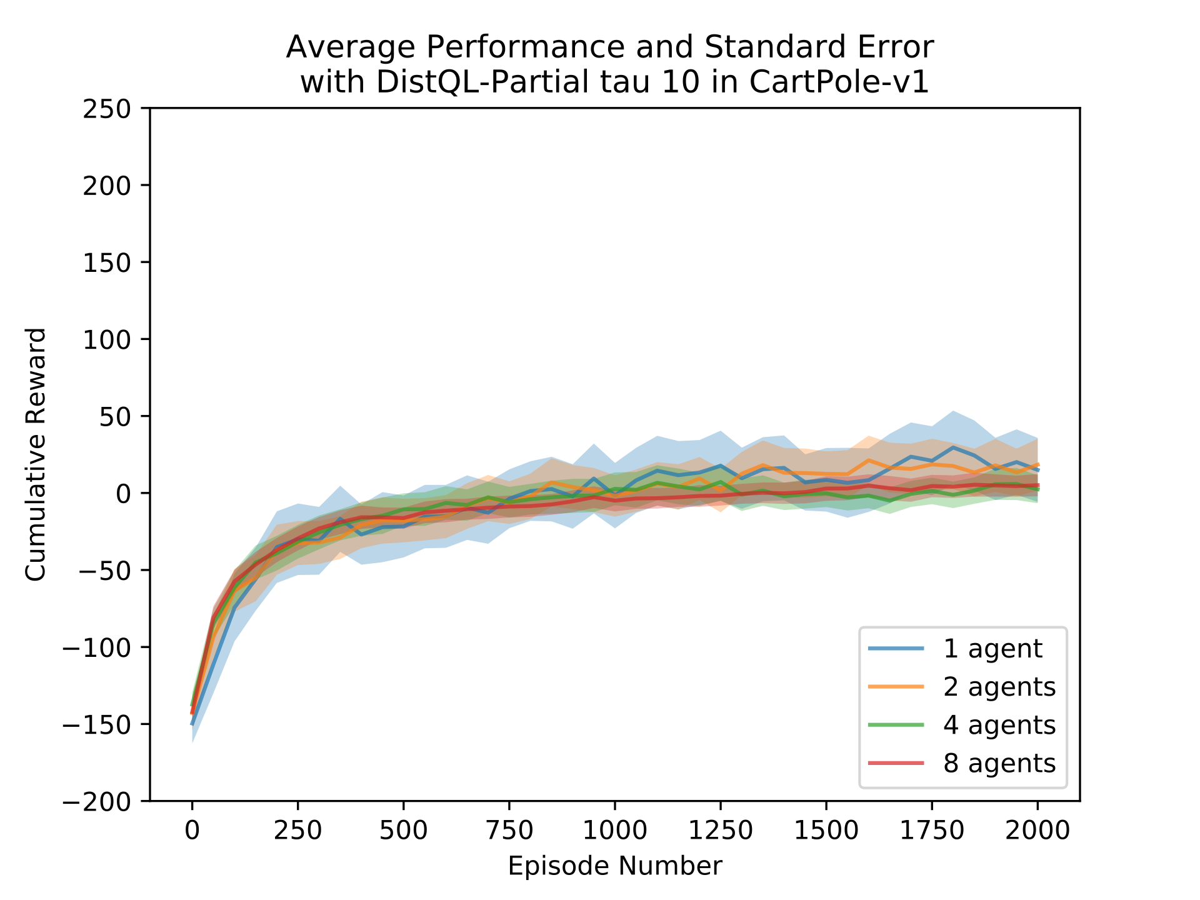
DistQL-ALL vs DistQL-Partial Cart Pole
Again, DistQL-ALL out performed DistQL-Partial for all agents

Slide 21
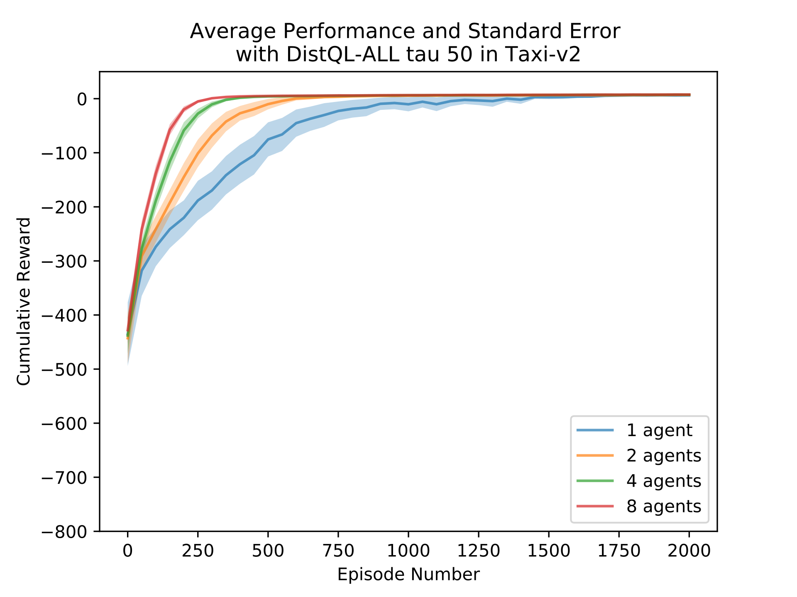
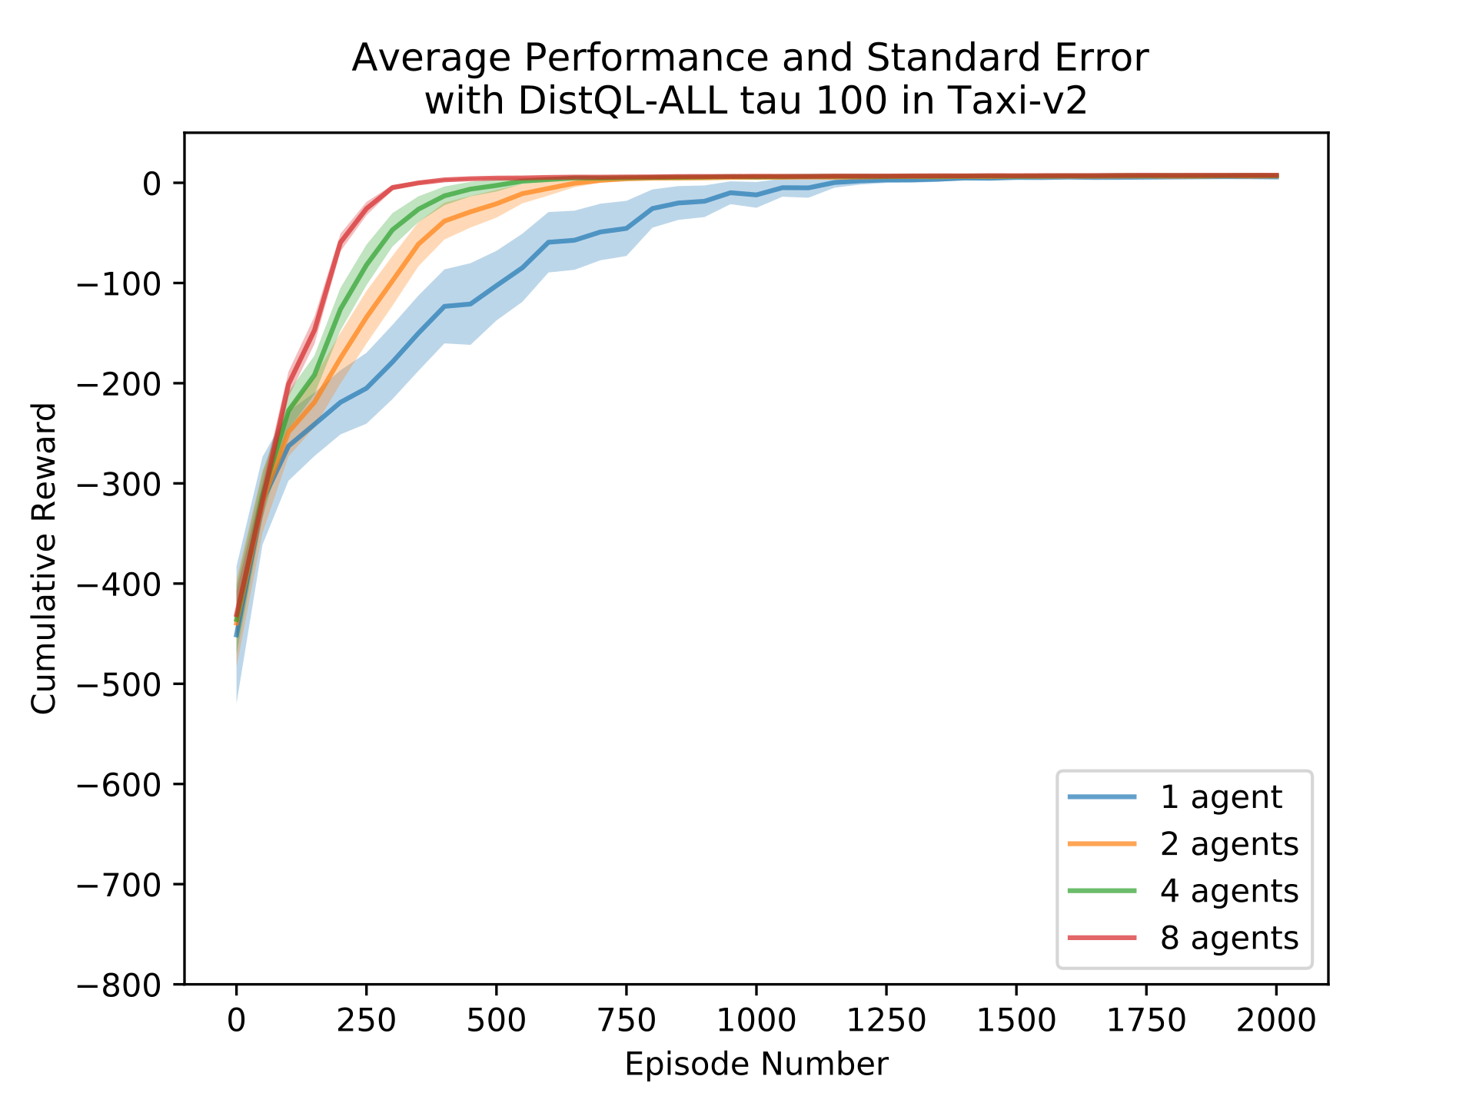
Update Frequency Effects
As $τ$ increases, performance increase become less prominent

Slide 22
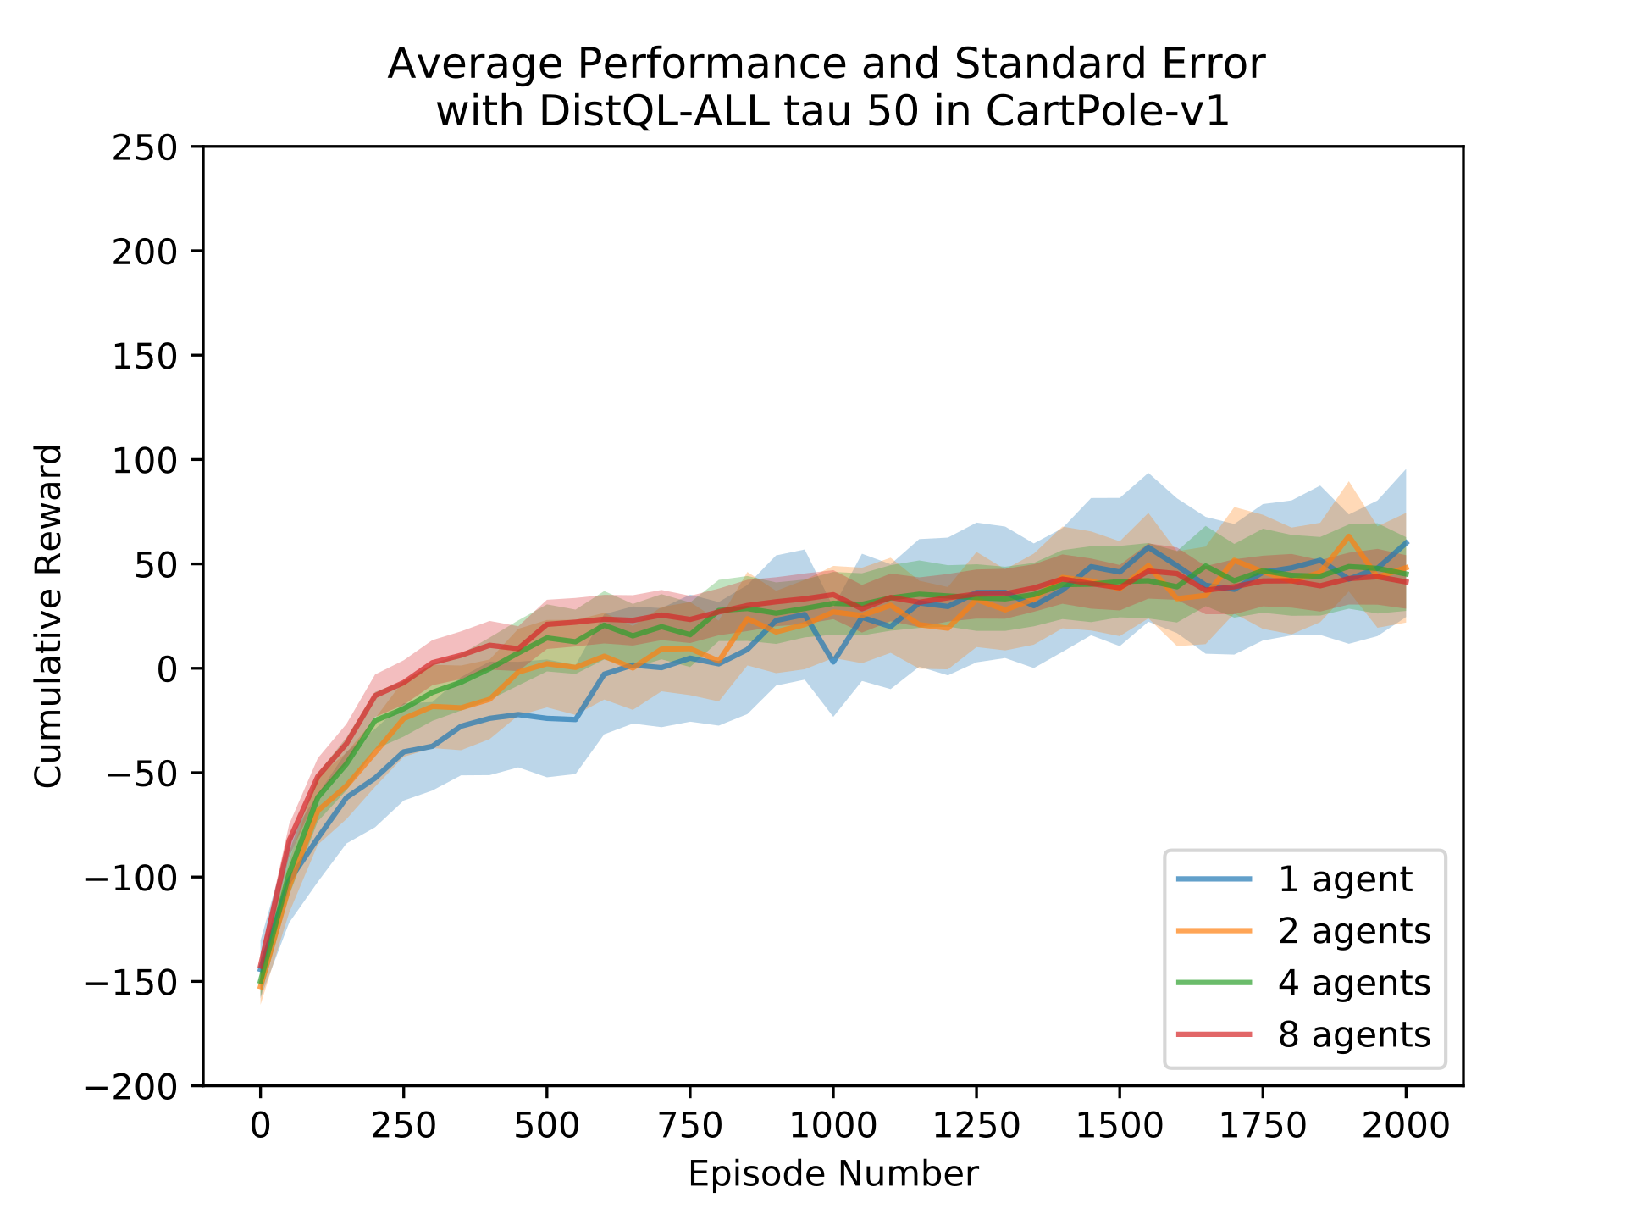
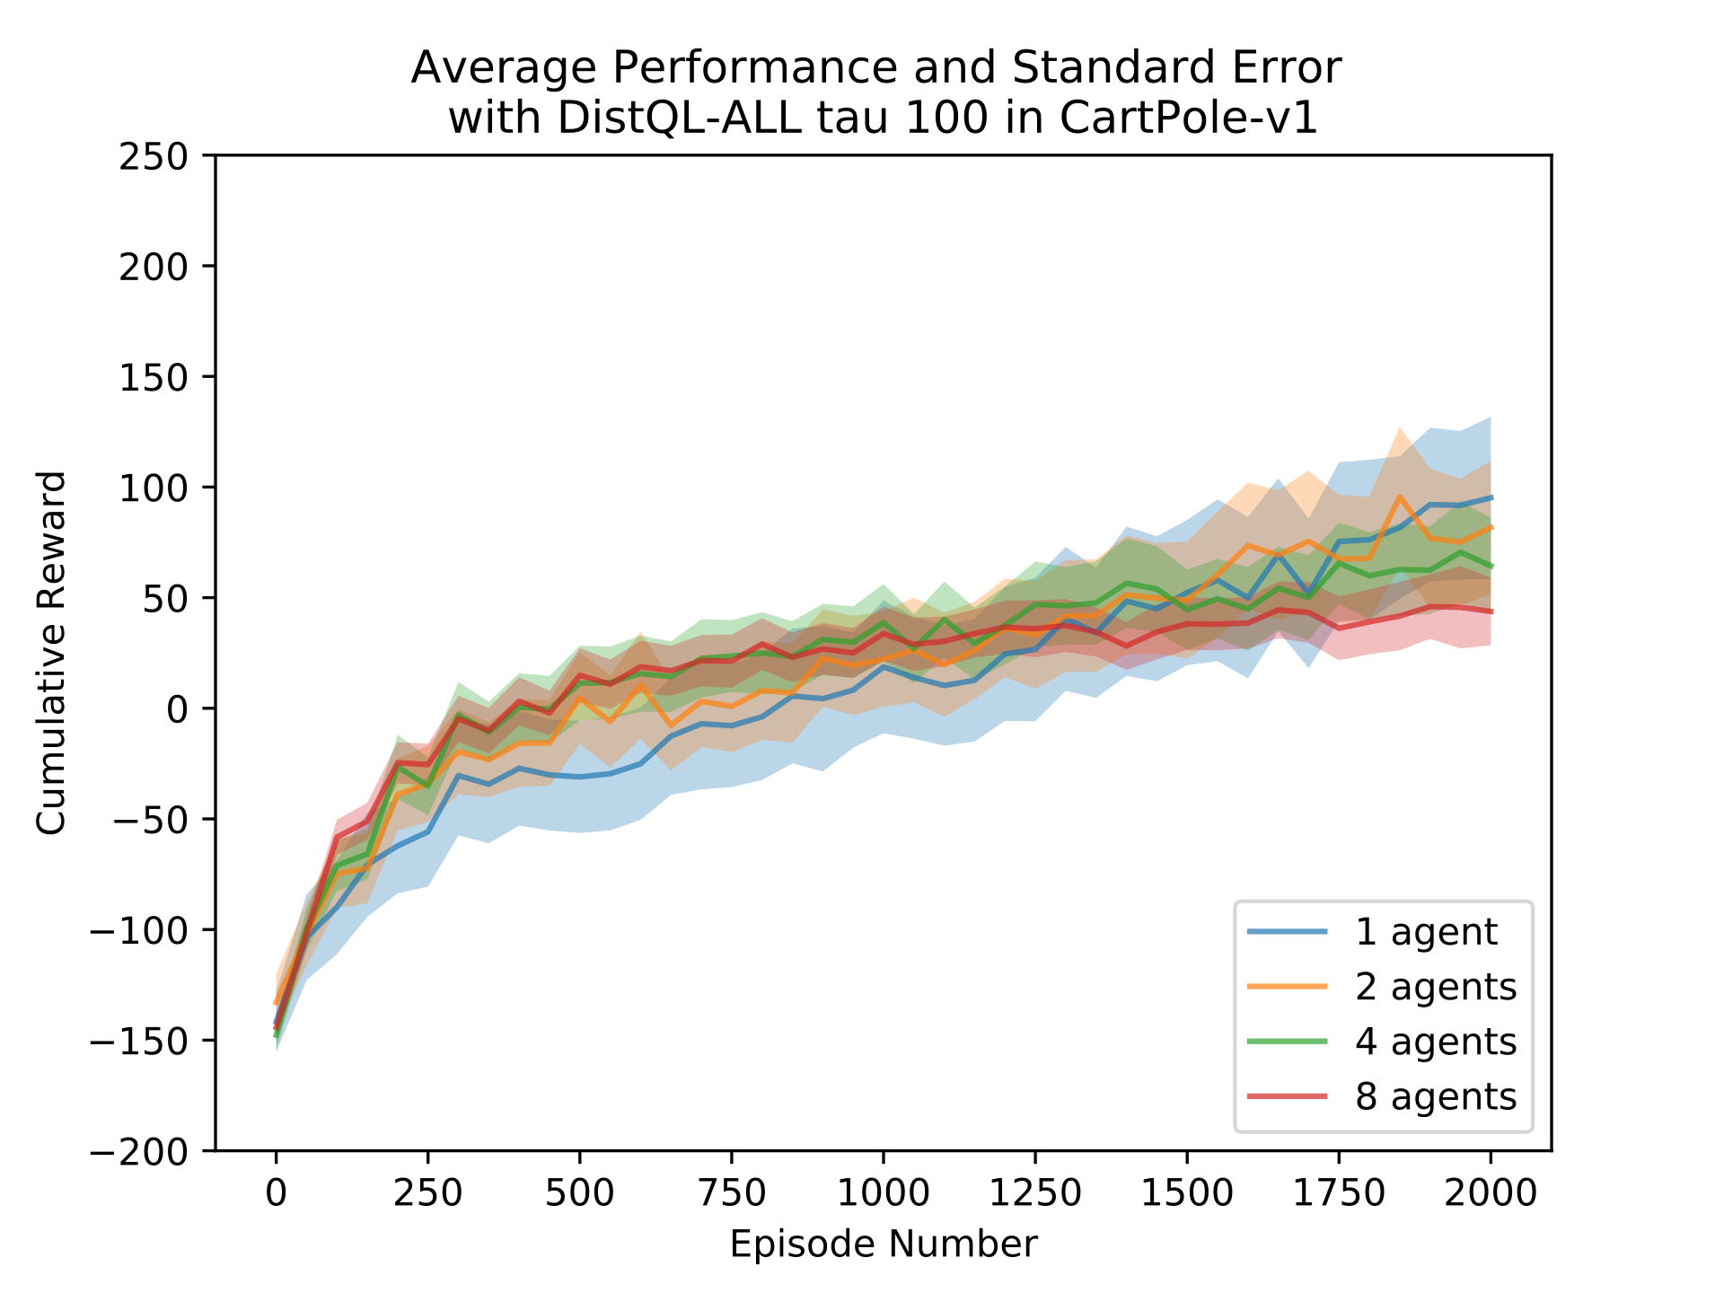
Update Frequency Effect
Again, as $τ$ increases, performance increase become less prominent

Slide 23
Where to now?

Slide 24
Future Work
New and different aggregation functions
Showing that the asynchronous updates conform to Tsitsiklis’(1994) assumptions.
Effects of different exploration strategies
Application to much larger problems

Slide 25
Questions?

Slide 26
References
Tsitsiklis, J. N. (1994). Asynchronous stochastic approximation and q- learning. Machine Learning, 16 (3), 185-202.
Mannion P., Duggan J., & Howley E. (2015). Parallel reinforcement learning for traffic signal control. Procedia Computer Science, 52, 956 { 961. The 6th International Conference on Ambient Systems, Networks and Technologies (ANT-2015), the 5th International Conference on Sustainable Energy Information Technology (SEIT- 2015).
Nair, A., Srinivasan, P., Blackwell, S., Alcicek, C., Fearon, R., Maria, A. D., Panneershelvam, V., Suleyman, M., Beattie, C., Petersen, S., Legg, S., Mnih, V., Kavukcuoglu, K., & Silver, D. (2015). Massively parallel methods for deep reinforcement learning. CoRR, abs/1507.04296.

